Slide 1
Shiny
An Introduction

Slide 2
Shiny
Shiny
“Shiny is an open-source R package that provides an elegant and powerful web framework for building web applications using R. Shiny helps you turn your analyses into interactive web applications without requiring HTML, CSS, or JavaScript knowledge”.
Provide a carefully curated set of user interface (UI) functions that generate the HTML, CSS, and Java Script needed for common tasks.
Reactive programming
Create dashboards that track important high-level performance indicators
Communicate complex models with an interactive sensitive analysis

Slide 3
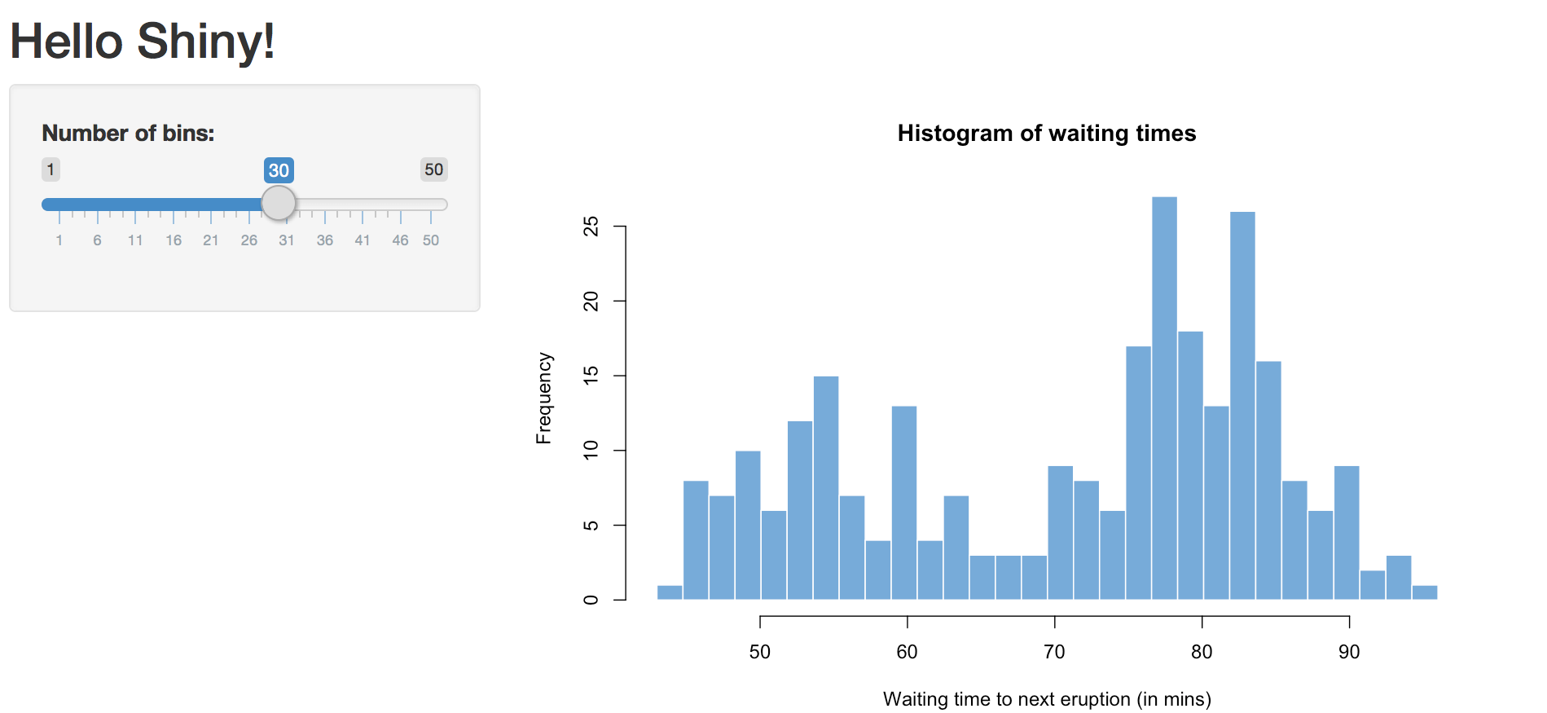
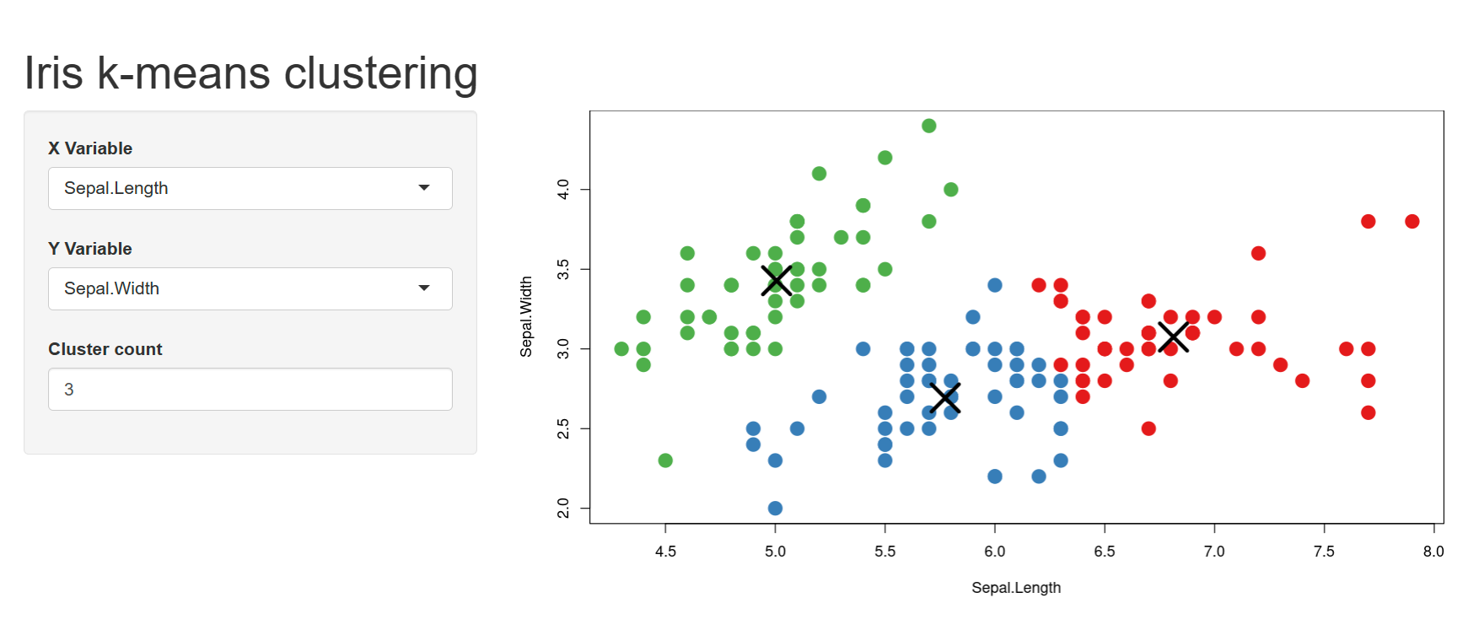
Examples Shiny Apps
Shiny
Shiny has a wide range of design uses. Examples include the following:
Interactive
Histograms
Scatter plots

Slide 4
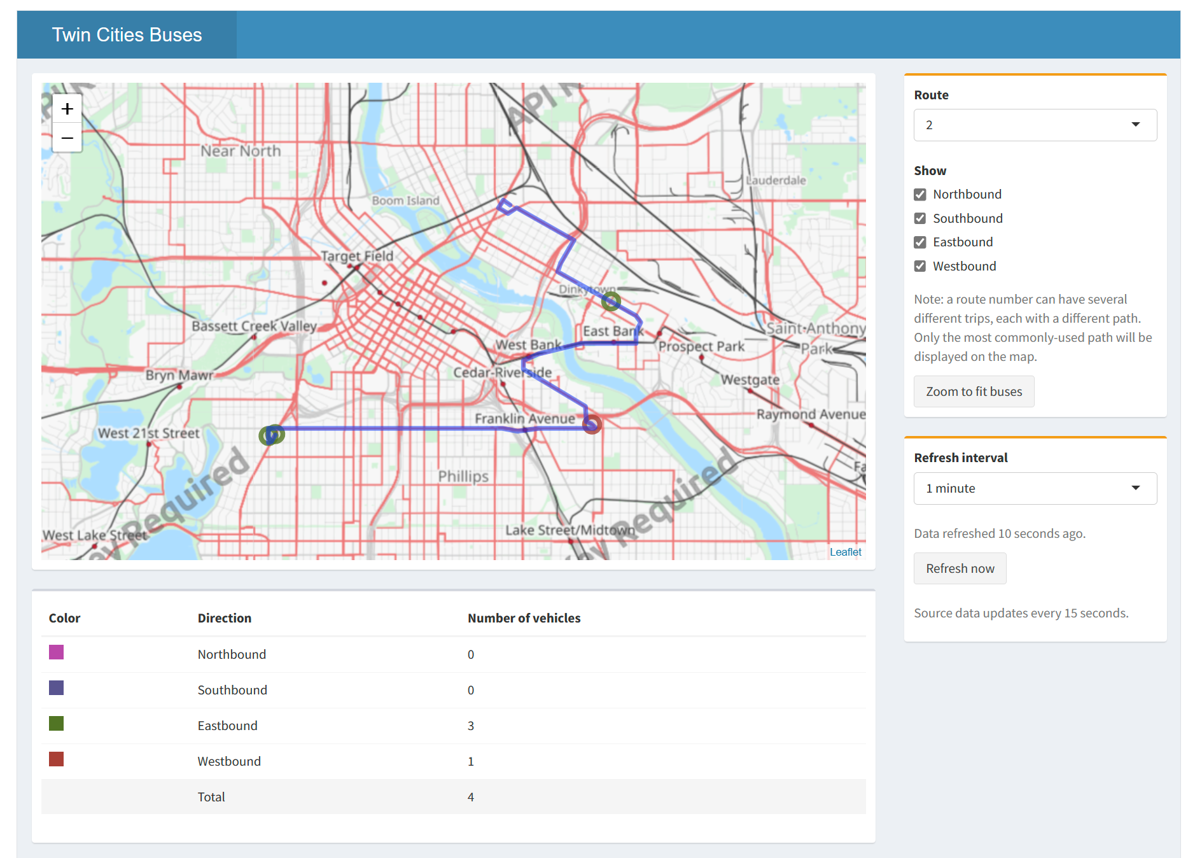
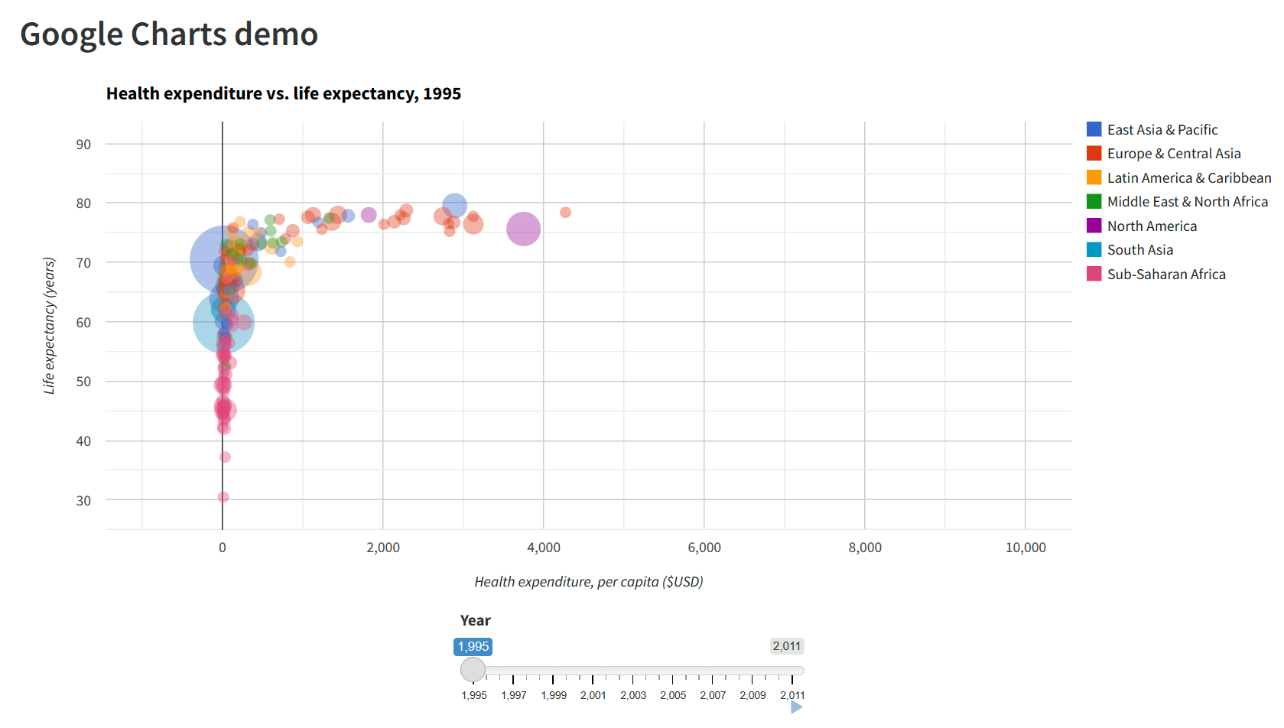
Interactive visualizations
Shiny
Shiny also could be used for fully interactive visualization.
Interactive map I
Graphs using Google Charts

Slide 5
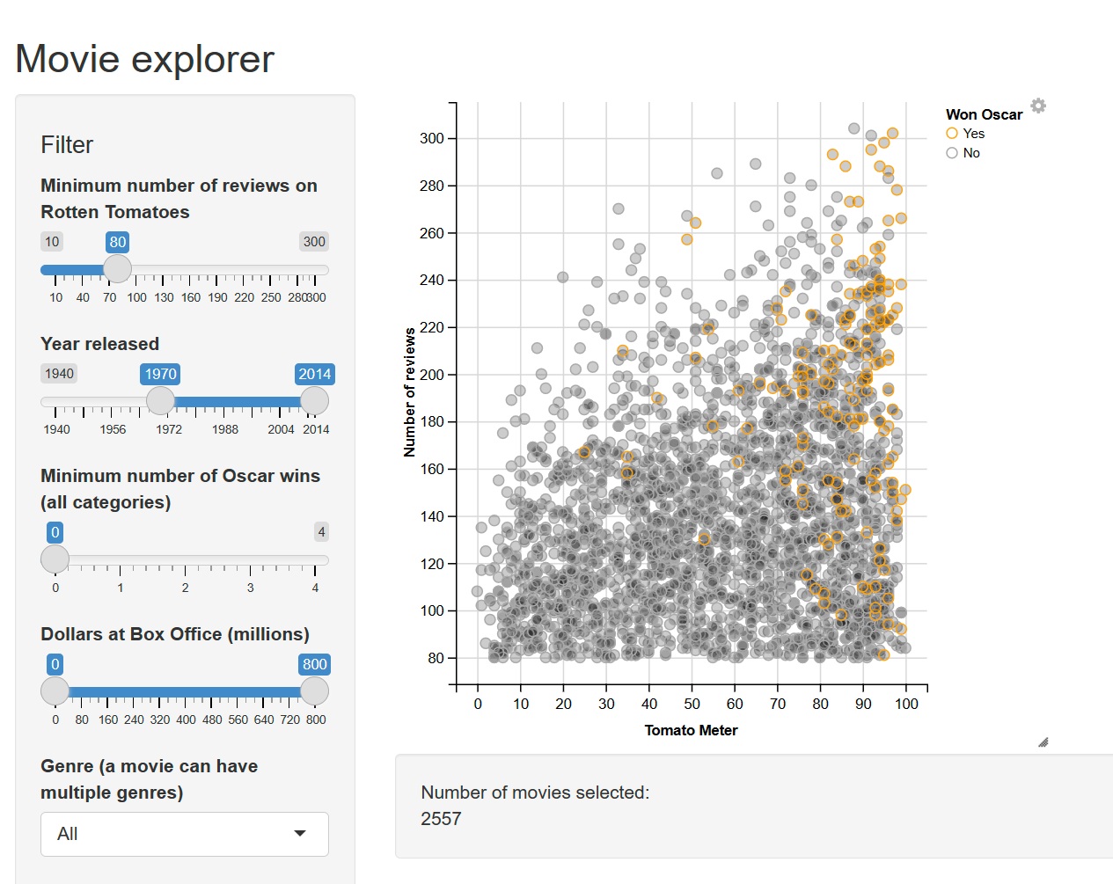
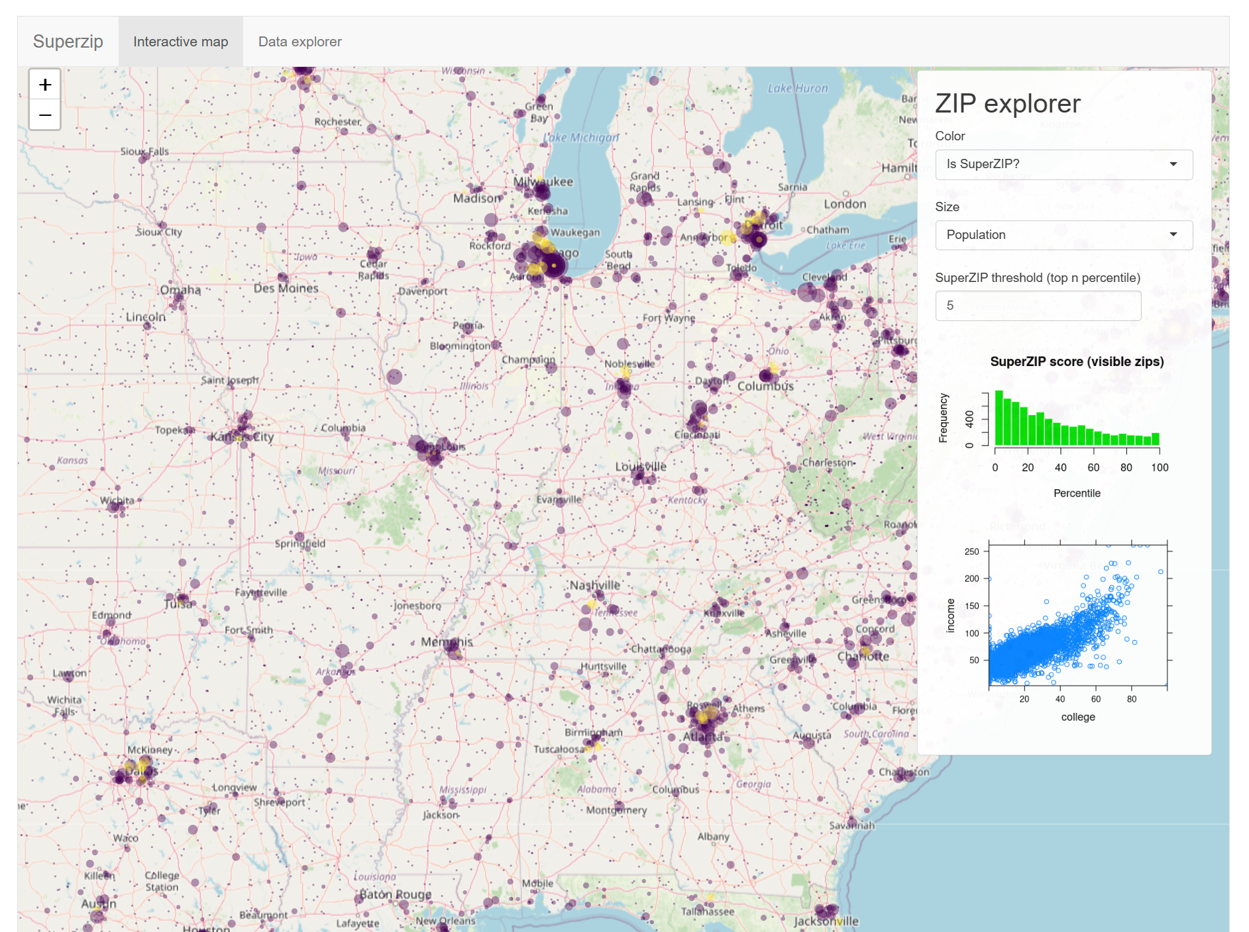
Interactive visualizations
Shiny
Interactive scatter plot
Interactive map II

Slide 6
CORE ELEMENTS

Slide 7
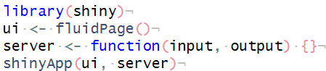
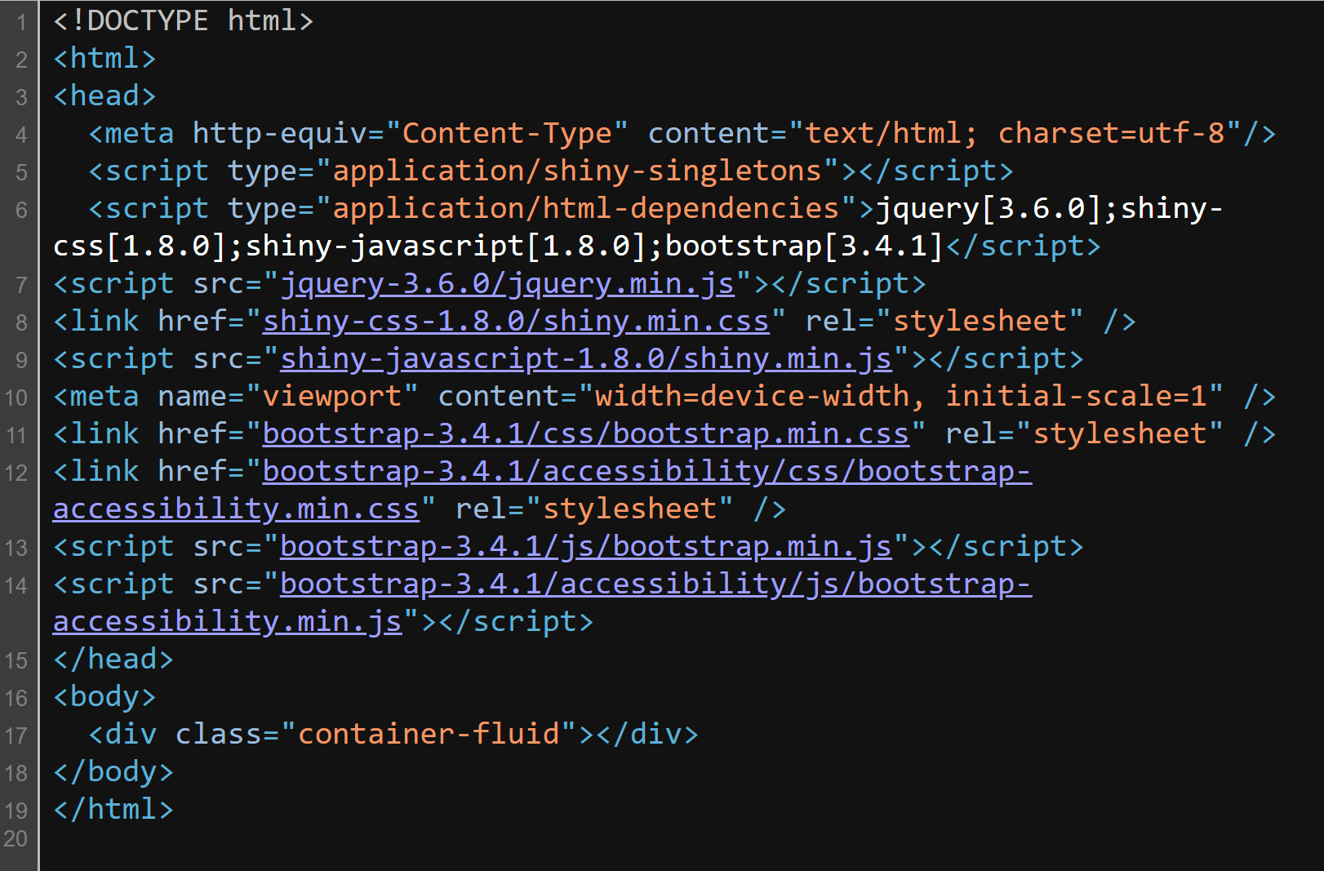
Empty App
UI. Nested R functions that assemble an HTML user interface
Inputs: Common structure, free text, numeric, dates, etc.
Outputs: Text, tables, plot, exercises, etc
Server. A function with instructions on how to build and rebuild the R objects displayed in the UI
Enables communication between a web server and an R server

Slide 8
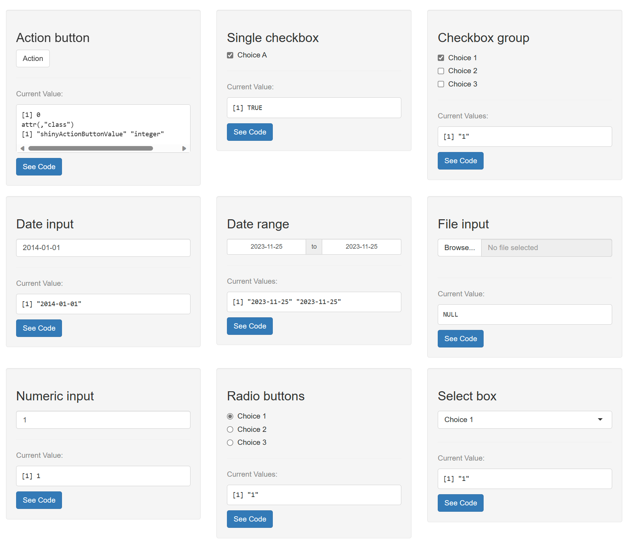
Inputs
There are many types of input controls.
The common structure starts with the argument: inputld and label
Inputld
It must be unique and identify one input widget
Inputld must be a simple string that contains only letters, numbers, and underscore.
Generates an interactive JS widget
Label
Create label for the control
It doesn’t has restrictions on this string

Slide 9
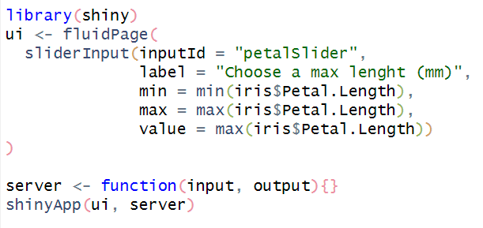
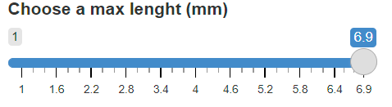
sliderInput
inputId. Name to use for look up the value of the widget
Label. Label to display above the slider bar
min. The minimum value
max. The maximum value
value. The initial value to display in the slider bar.

Slide 10
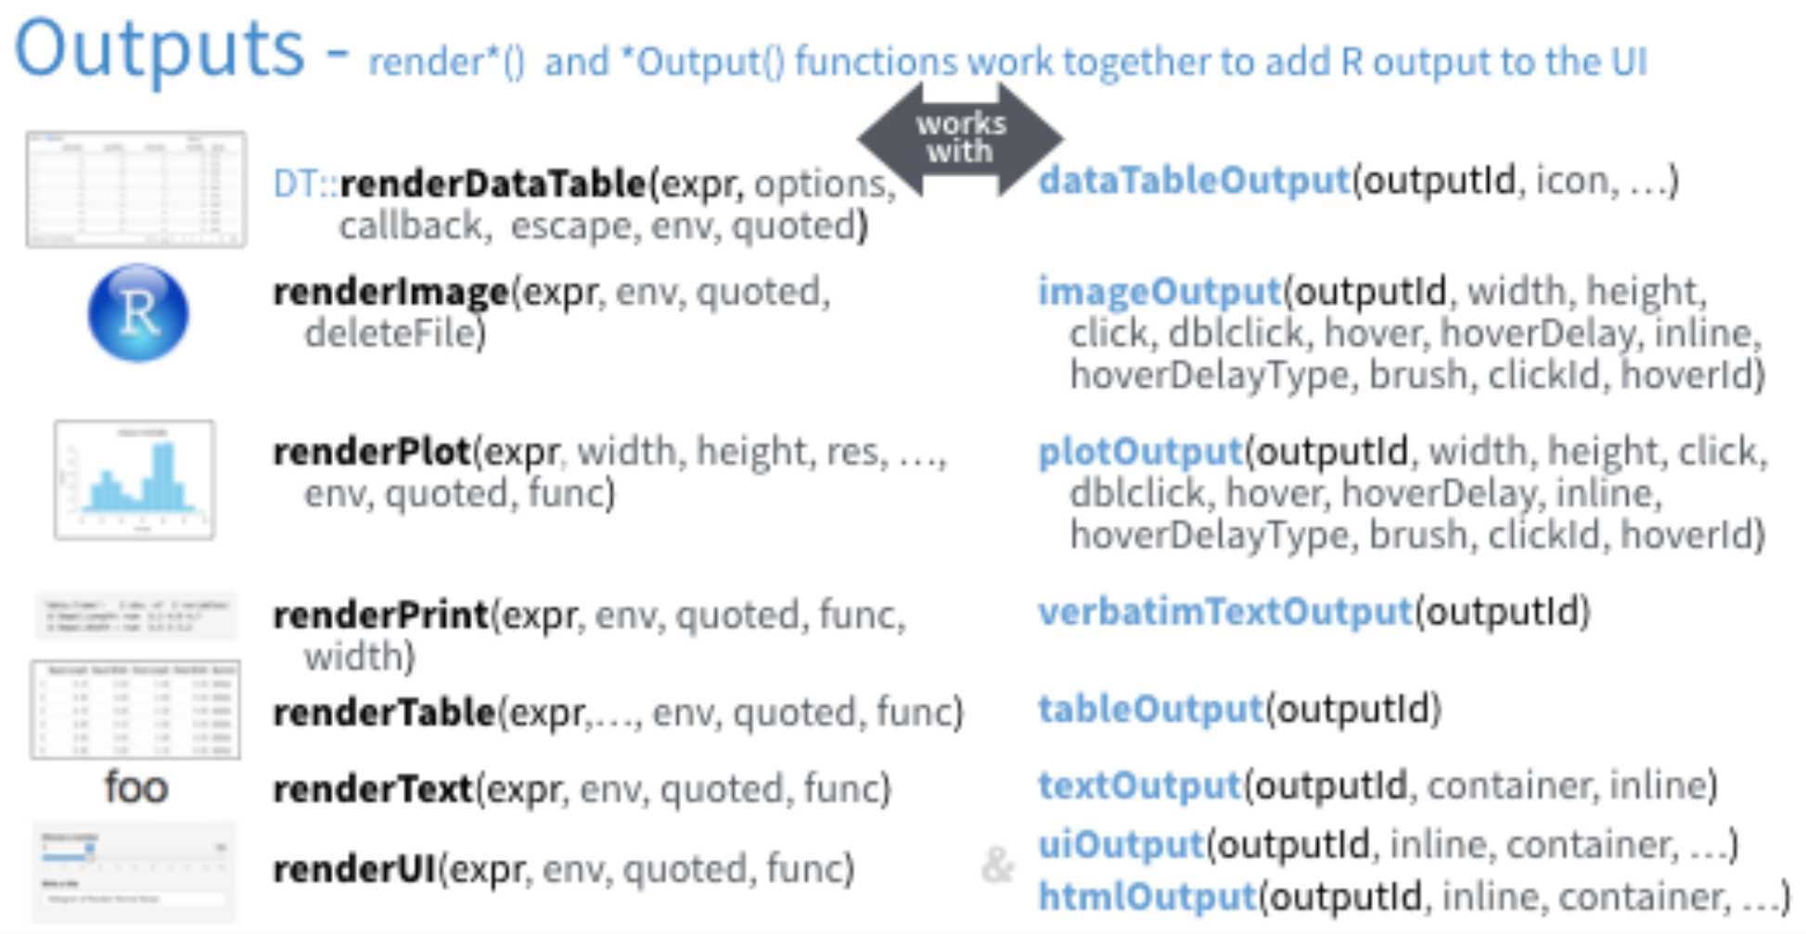
Outputs.
There are many types of outputs controls.
The only requiere structure is: outputld
Outputld
It must be uniquely identify one widget
Some output objects can themselves be used to capture user input.
Output function on the front end is coupled with a render function in the back end.
The three main types of output could be included in a report: text, tables, and plots.

Slide 11
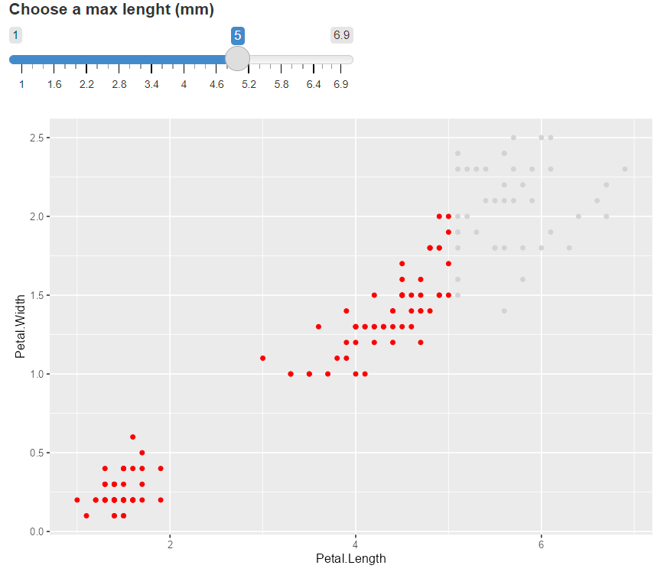
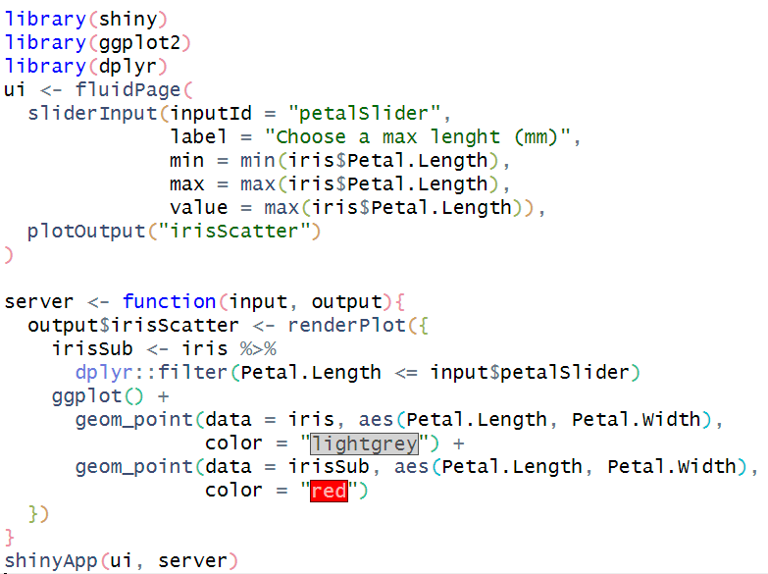
plotOutput

Slide 12
Practice
¿Shiny in Research?
CV with Shiny
Presentation of one of our projects

Slide 13
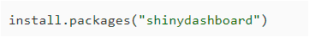
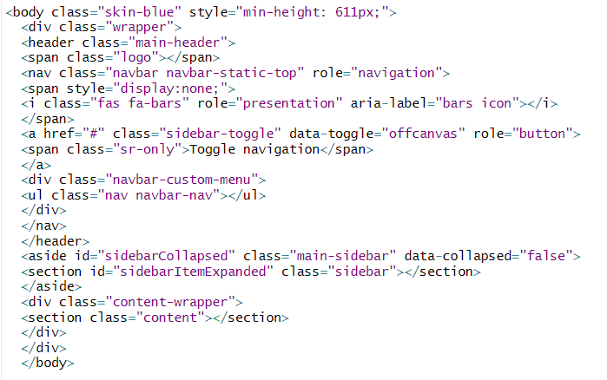
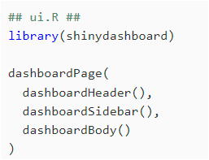
Shinydashboard
A dashboard has three parts: a header, a sidebar, and a body. Here’s the most minimal possible UI for a dashboard page.

Slide 14
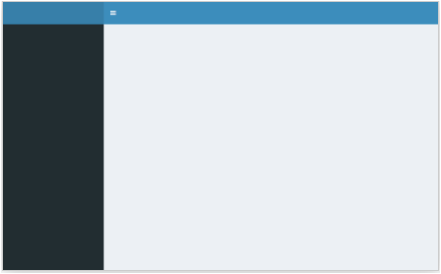
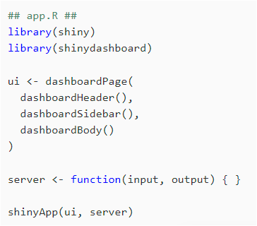
Shinydashboard
Header
dashboardSidebar(),
Sidebar
Body
dashboardBody(

Slide 15
Shinydashboard
UI. Nested R functions that assemble an HTML user interface
Inputs: Common structure, free text, numeric, dates, etc.
Outputs: Text, tables, plot, exercises, etc
Server. A function with instructions on how to build and rebuild the R objects displayed in the UI
Enables communication between a web server and an R server
Input. Represents the elements of the user interface (UI) that users can manipulate, such as sliders, buttons, etc.
Output. Represents the elements that will be dynamically updated in the UI in response to changes in the input.

Slide 16
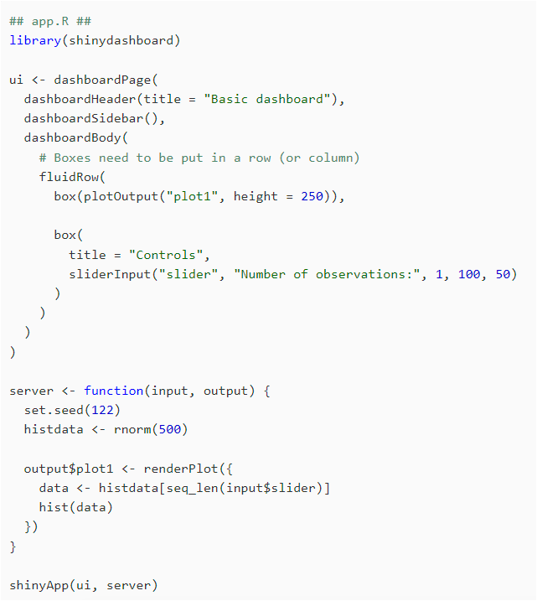
In the body we can add boxes that have content.
dashboardSidebar(),
dashboardBody(
fluidRow(
histdata contiene 500 valores aleatorios generados a partir de una distribución normal
)
)
data contiene un subconjunto de histdata basado en el valor del slider de entrada (input$slider)
seq_len(input$slider) crea una secuencia de números del 1 al valor del slider.

Slide 17
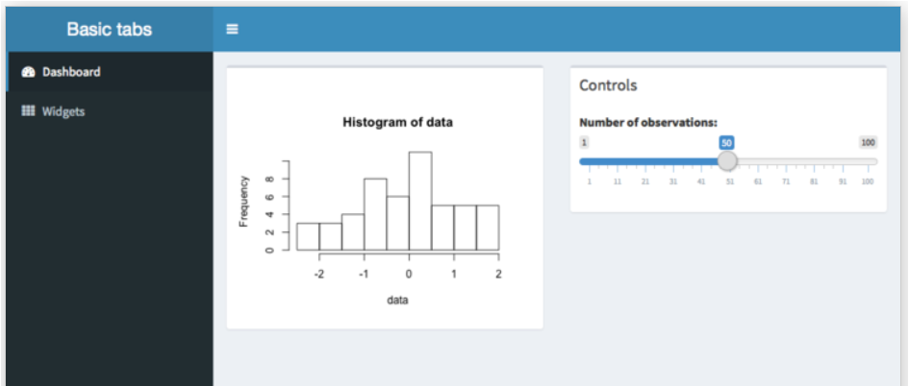

Slide 18
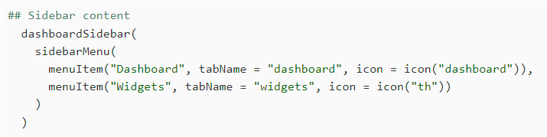
Sibedar
Next, we can add content to the sidebar, we’ll add menu items that behave like tabs. These function similarly to Shiny’s tabPanels: when you click on one menu item, it shows a different set of content in the main body.
dashboardSidebar(),

Slide 19
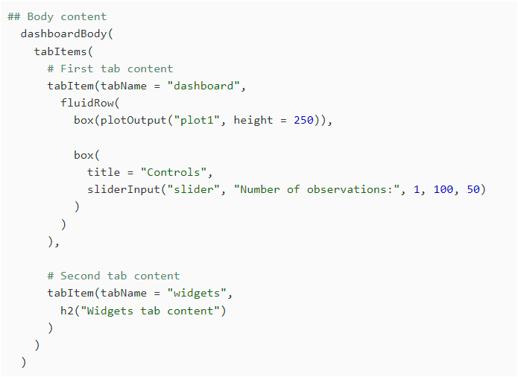
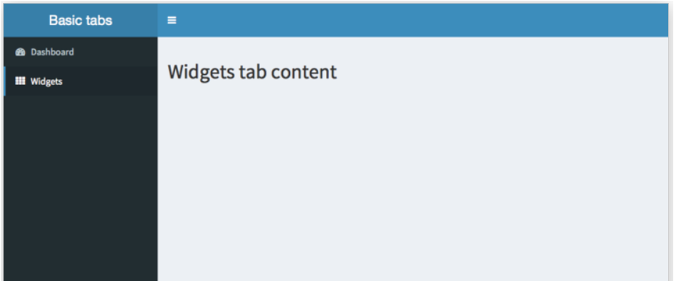
Sibedar
In the body, add tabItems with corrsponding values for tabName:
tabItems(
)

Slide 20
References
https://rstudio.github.io/shinydashboard/get_started.html
https://rstudio.github.io/shinydashboard/structure.html

